Slide 1

MAYUR PAINTS WEBSITE
Presenter Name:-
Rishabh Malhotra
Enrol. No: 02596302714
Btech (CSE) – 5th SEM

Slide 2
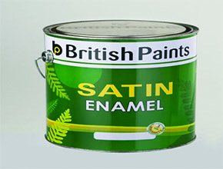
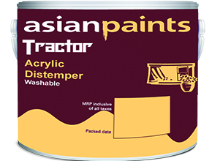
About Company
Mayur International is a paint retailing and selling company in India, offering Paints at lowest possible prices as it deals with many paint companies directly. Mayur International has also been expanding its service presence in hardware tools also.
Since its inception on November 16, 2002, Mayur International has been a frontrunner in providing it’s customers with best quality paints.
Mayur International’s vision is that each and every individual will make its special place a beautiful one with best quality paints. Over the last decade, Mayur International continues to bring the benefits to it’s customers at many levels. Mayur International’s mission is to deliver paints at cheapest level to its customers and they also provide colour experts to decide which colour and texture suits best to a individual’s place.
Mayur International’s office is at 9, Block A-2, DDA Society, Paschim Vihar, New Delhi-110063.

Slide 3
Brief About the Project
TITLE | Mayur Paints Website
Objective | To make a dynamic(in context of its content), user friendly website for it’s user
Front End | HTML , CSS , JavaScript , Jquery, Bootstrap
Back End | PHP
Platform | Sublime Text, Brackets,Xamp Control panel

Slide 4



Languages Used
HTML
CSS
JAVASCRIPT
PHP

Slide 5
Features Of The Website

Slide 6
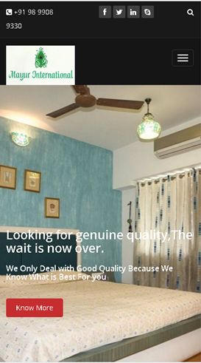
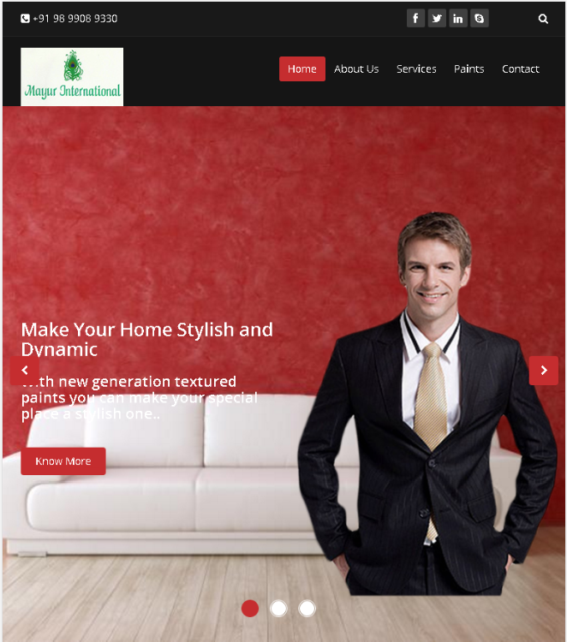
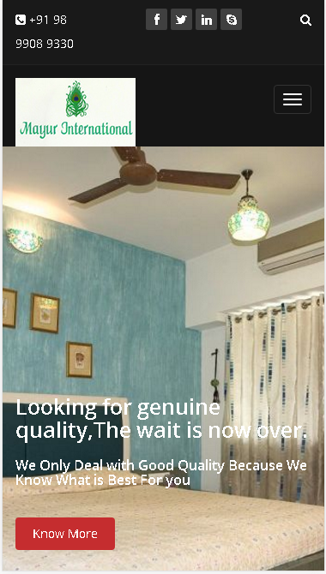
RESPONSIVE WEB DESIGNING
Used Bootstrap and media
tags for different screen sizes

Slide 7
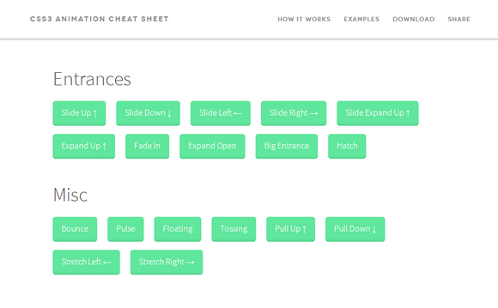

SOME MORE FEATURES…..
Smooth Scrolling
User Friendly
Faster to load
Various Animations Used

Slide 8

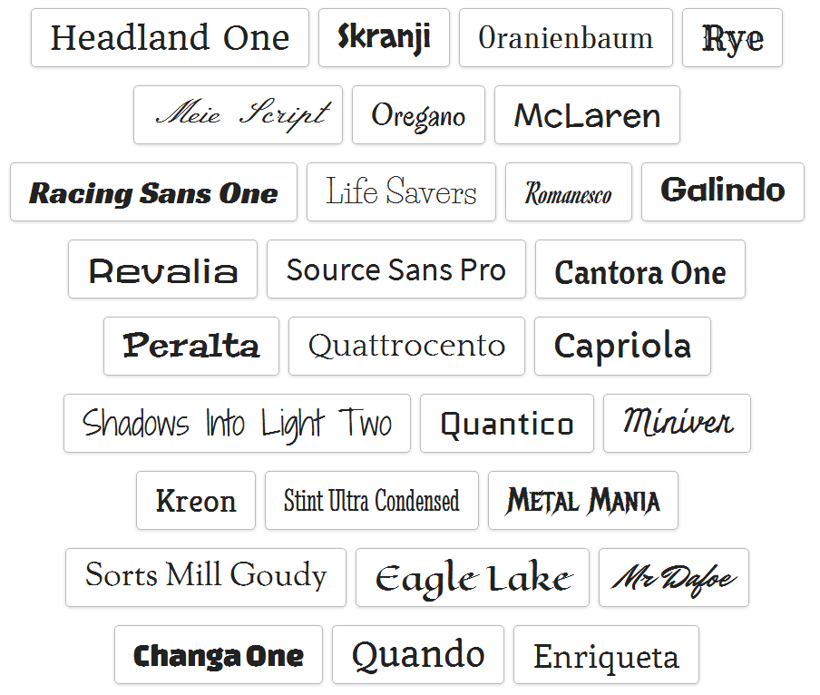
API’s Used
Google API’s i.e., maps and fonts

Slide 9
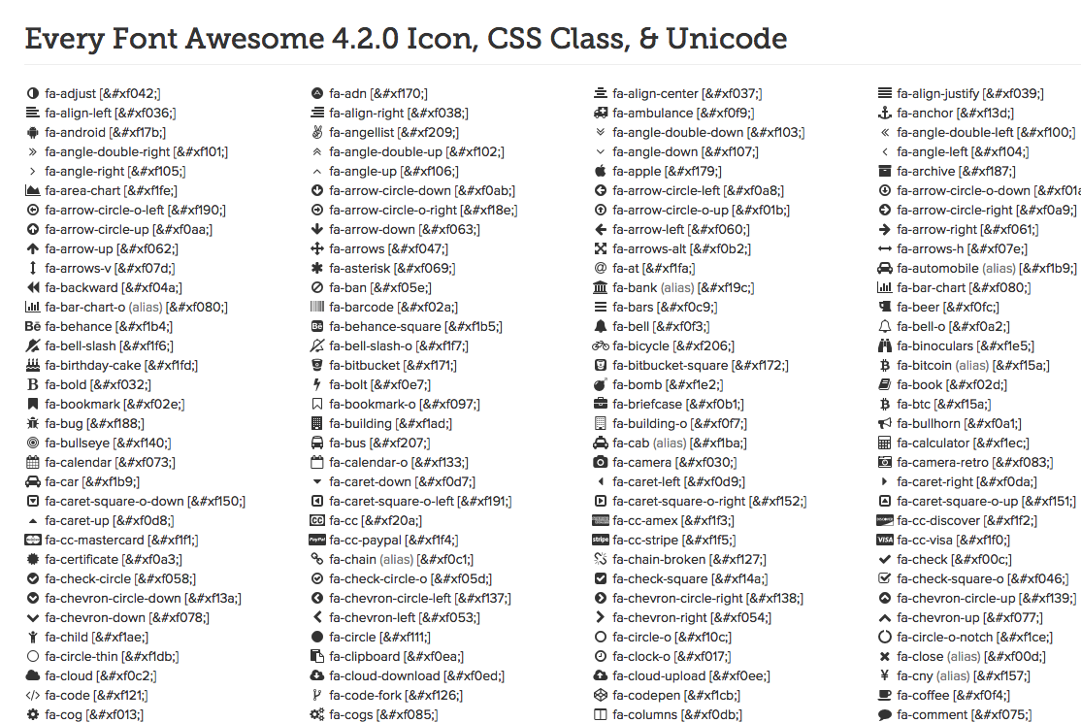
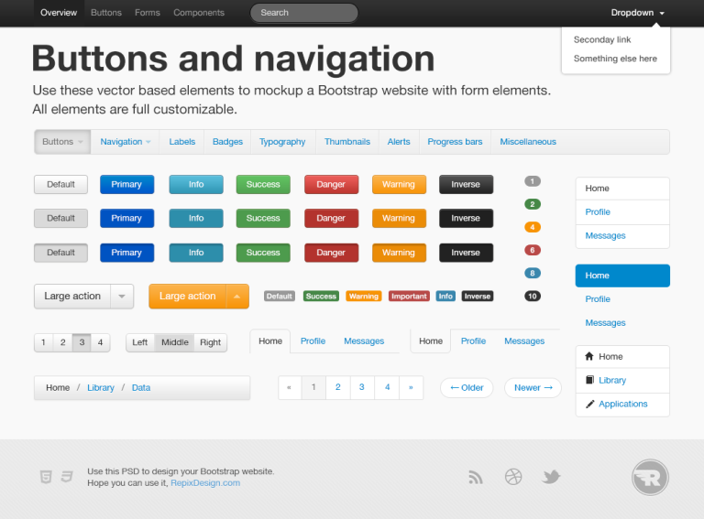
LIBRARIES USED
BOOTSTRAP
Wow.js
Animate.css
Font Awesome
Jquery

Slide 10
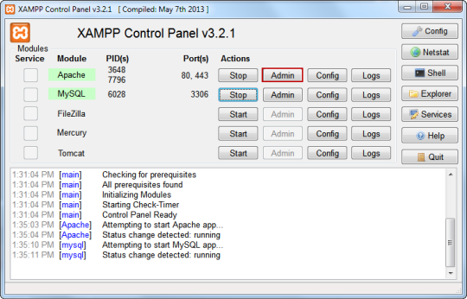

Tools Used
Xampp Control panel to test php,As they run on only servers.

Slide 11
SNAPSHOTS

Slide 12
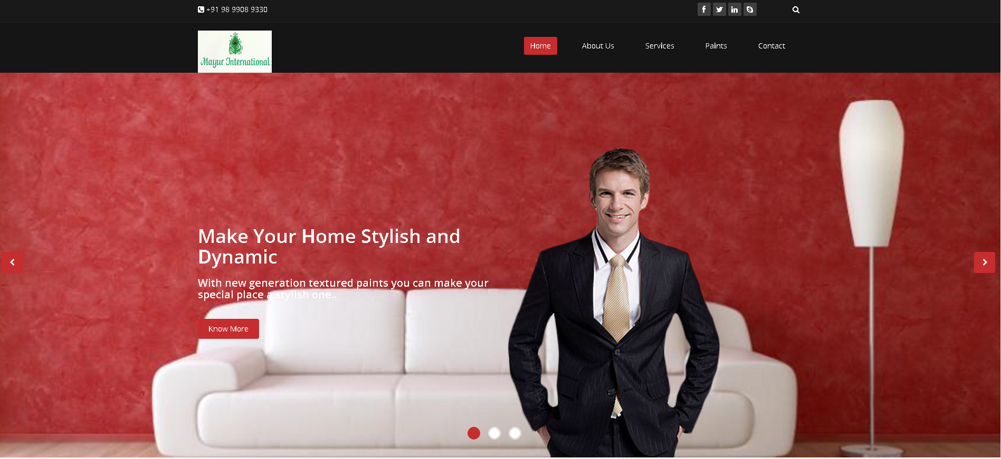
HOME PAGE
This section consists of a carousel made using JavaScript and Jquery

Slide 13
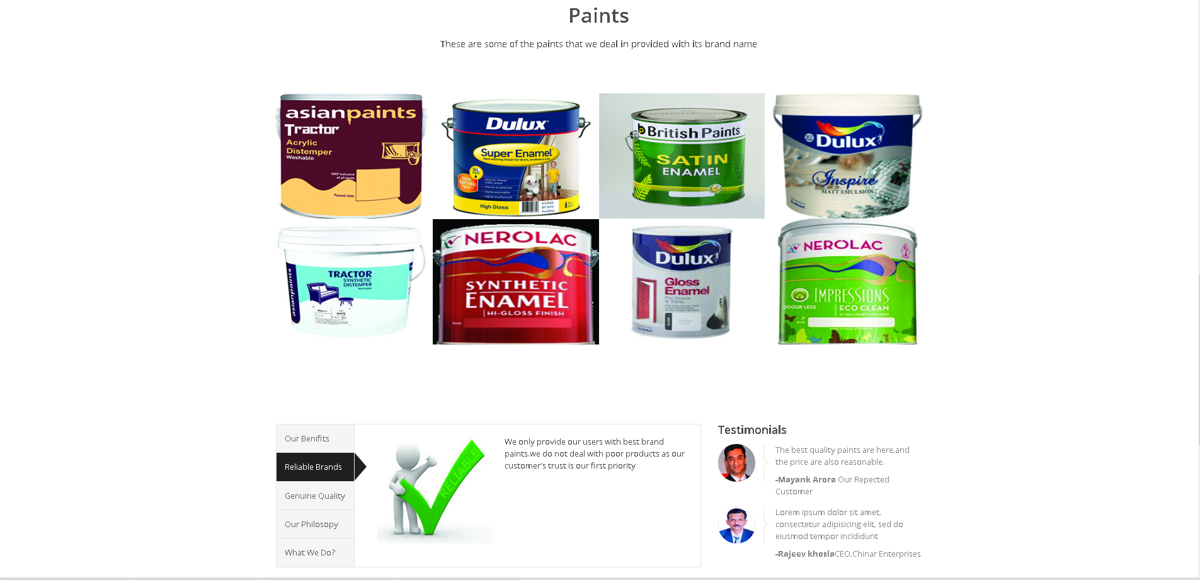
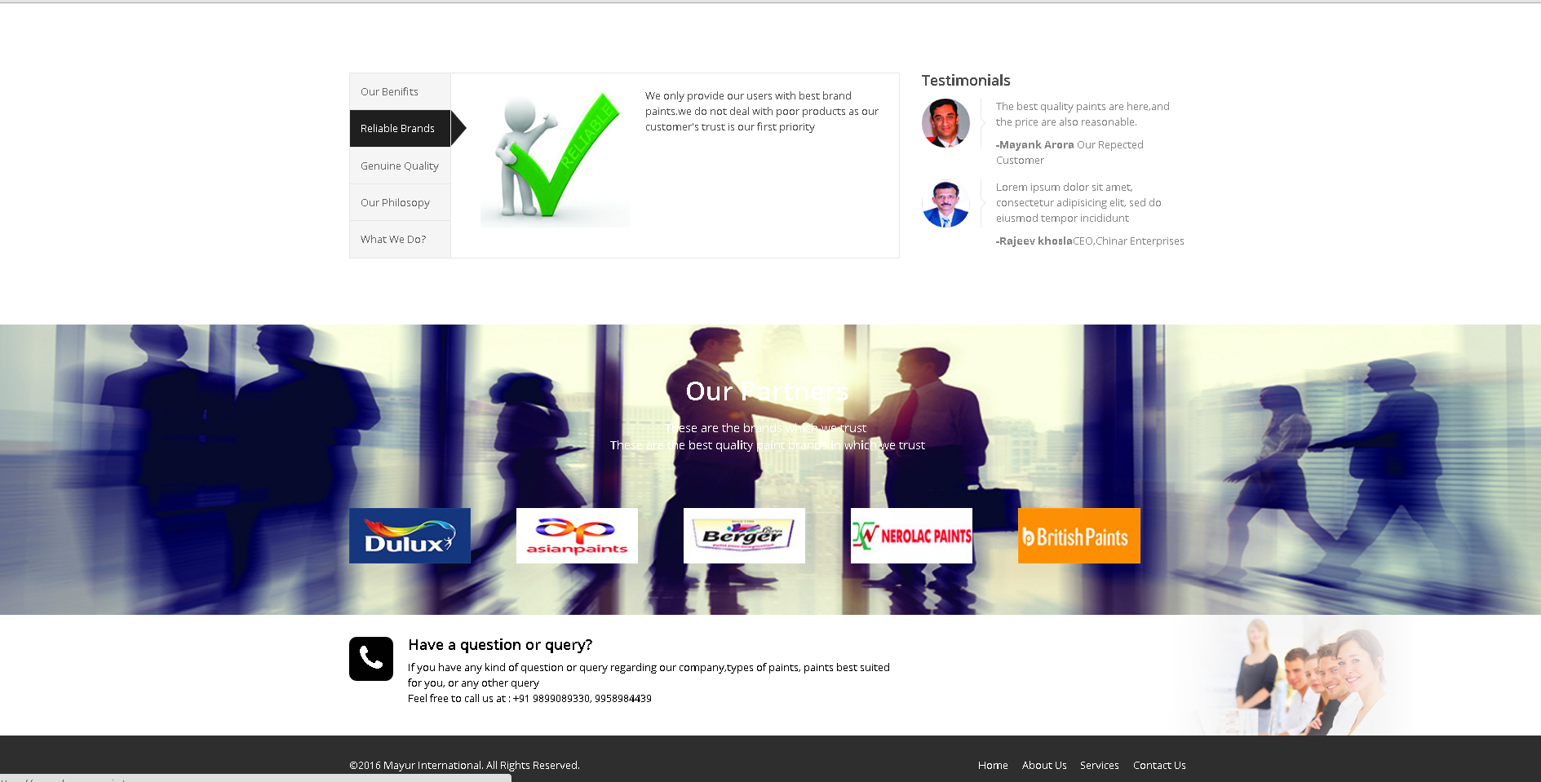

Slide 14
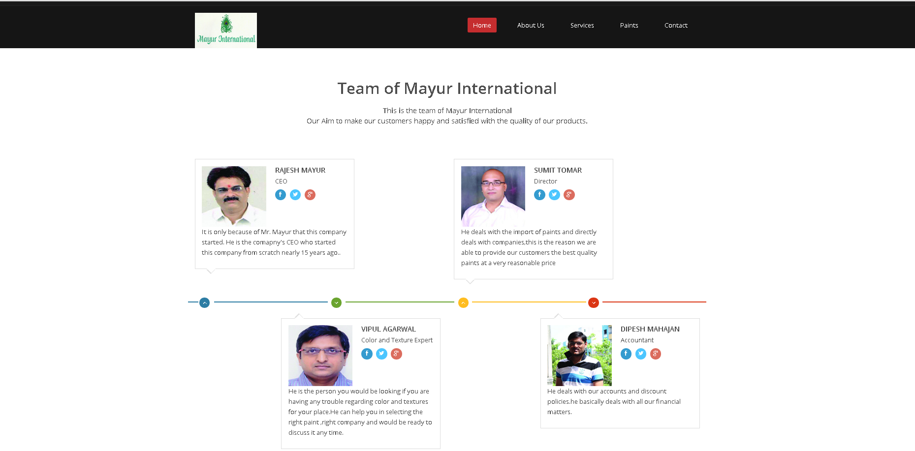
ABOUT US PAGE
This is the about us page of the website which tells about employees of the company

Slide 15
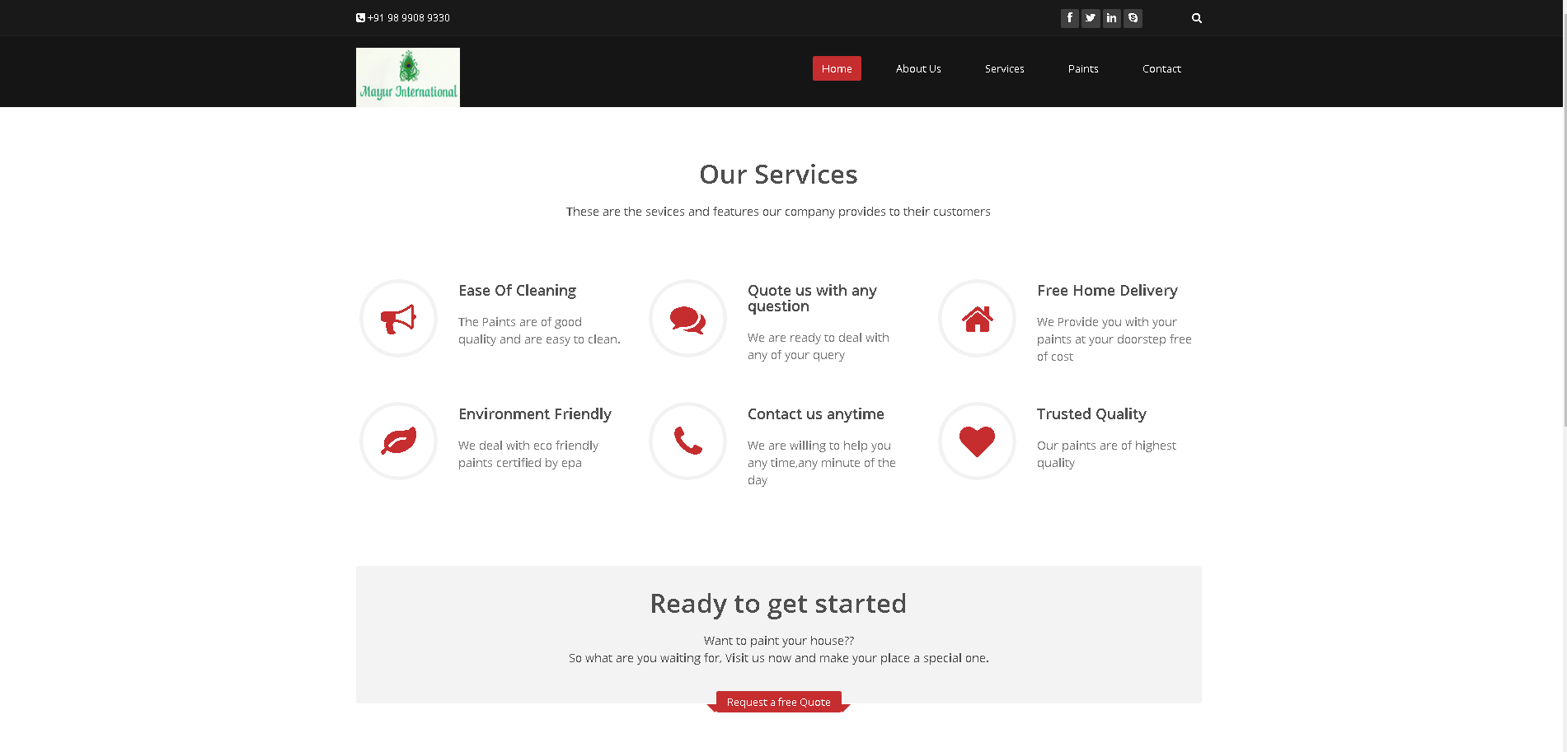
SERVICES PAGE
This is the Services page and all the icons used here are from font awesome,
icons library

Slide 16
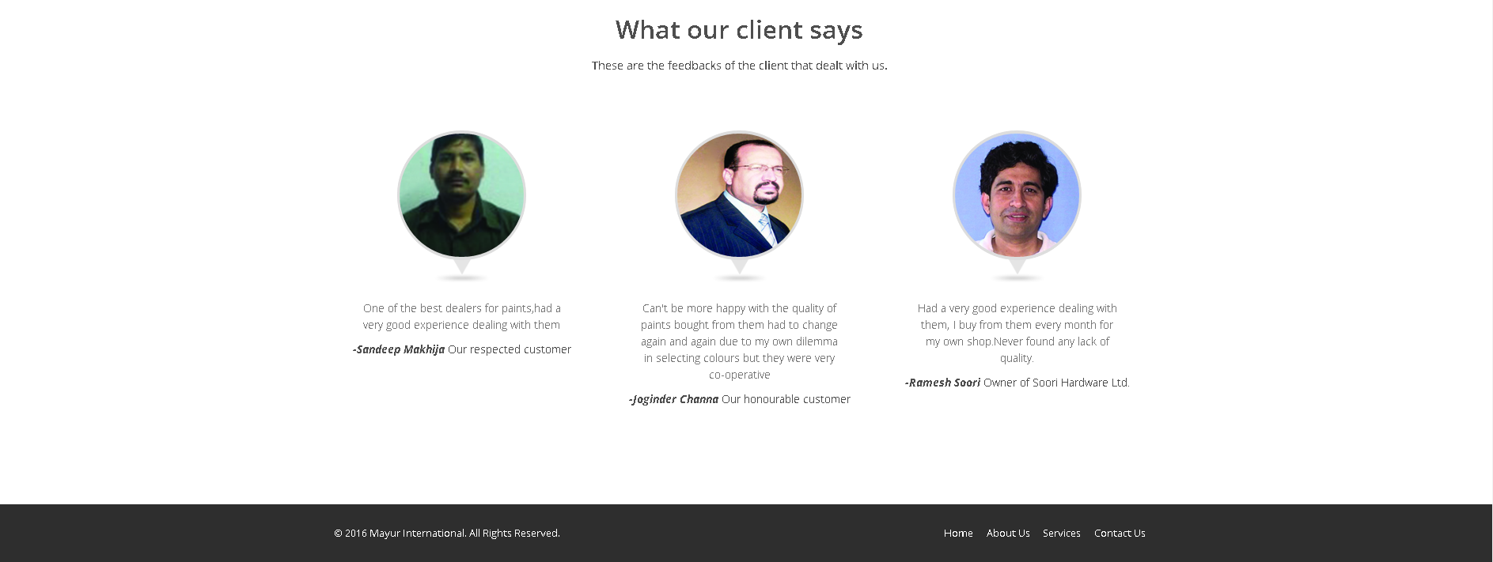
This is the testimonials section

Slide 17
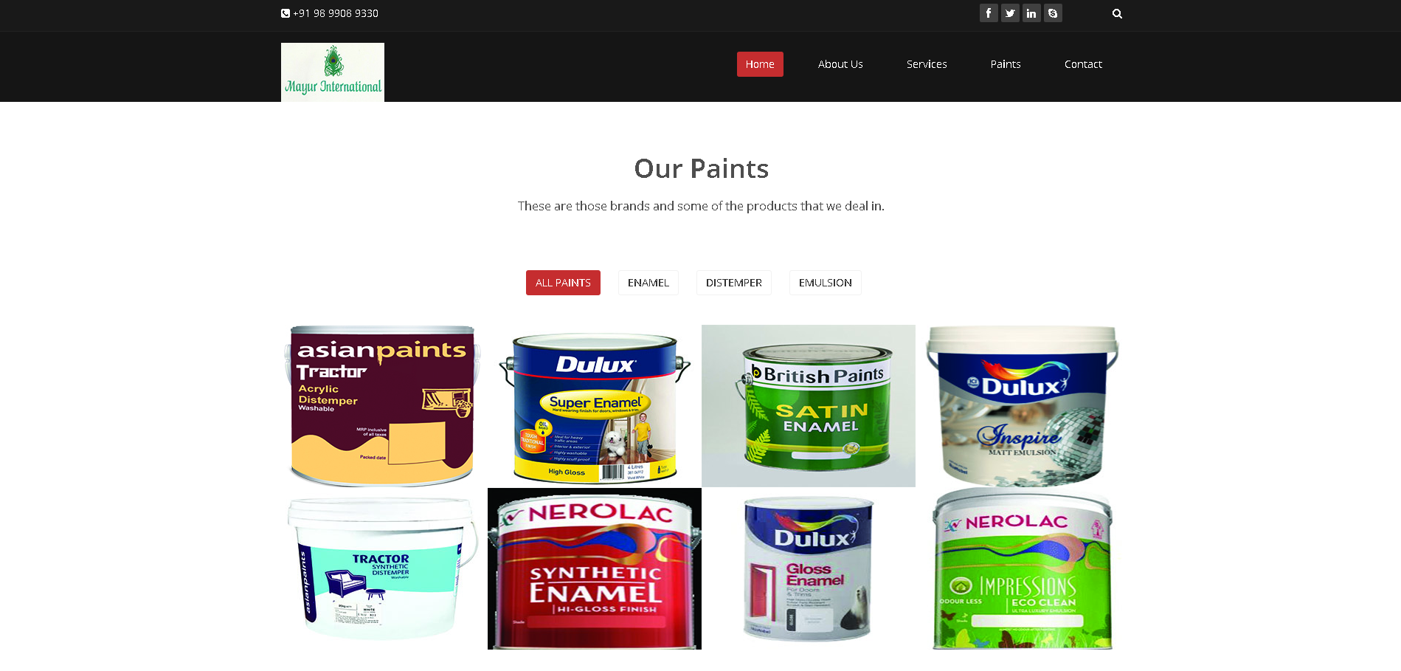
PAINTS PAGE
This is the paints page it will display the different paints that the company majoritarily deals with .Here I also used the filter to sort the different types of paints like enamel, emulsion and distemper

Slide 18
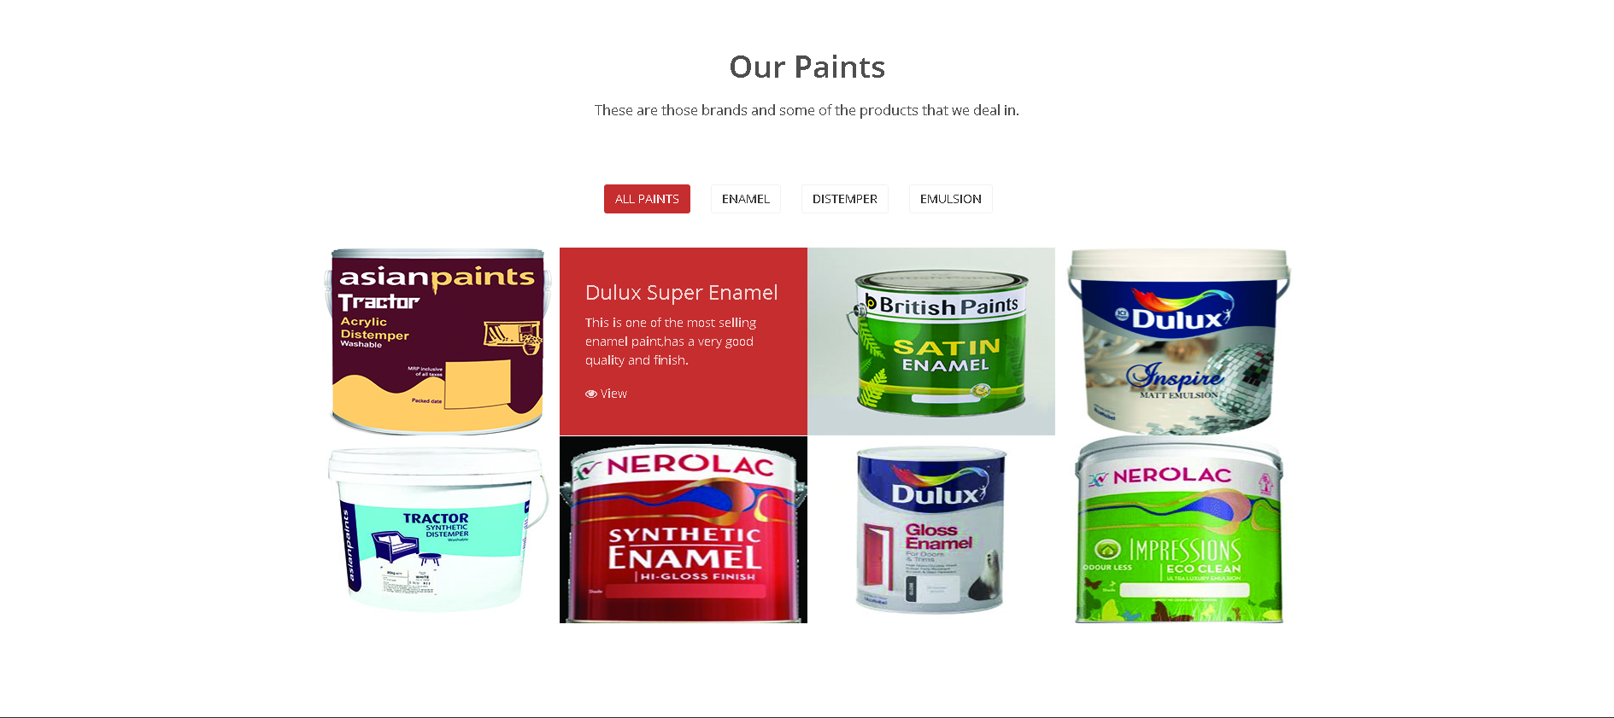
If you hover on any of the paint image you would be provided with a breif description about that particular paint

Slide 19
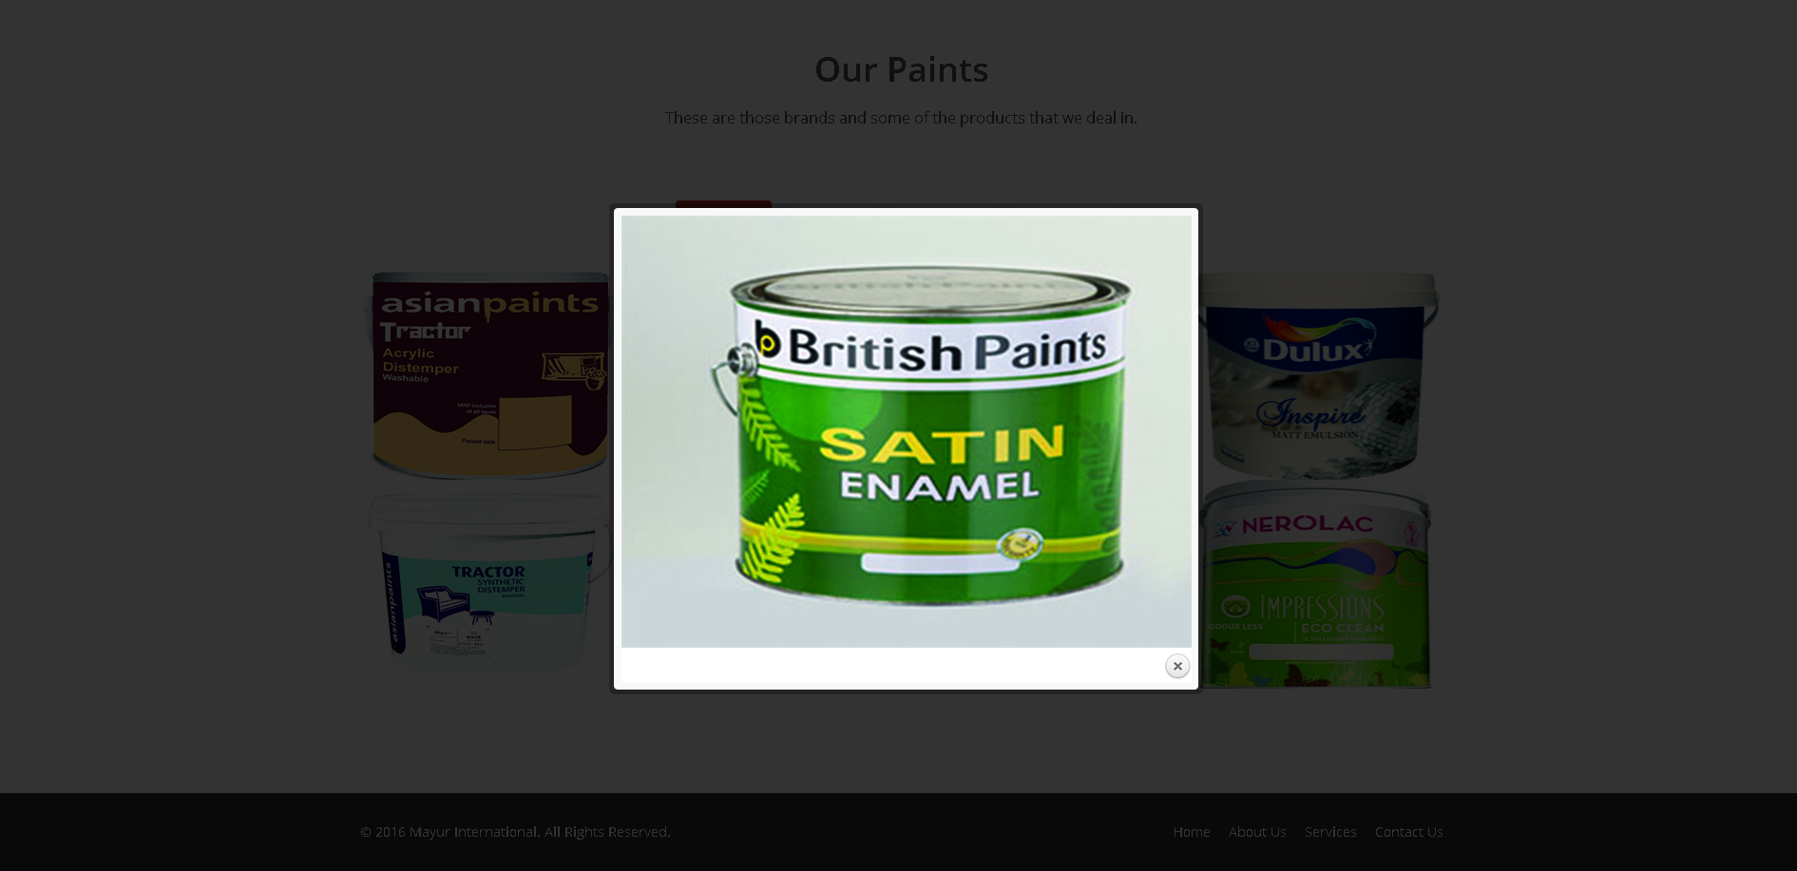
On clicking on the view block present on each of the following paints description you would be provided with a zoomed image of that paricular paint

Slide 20
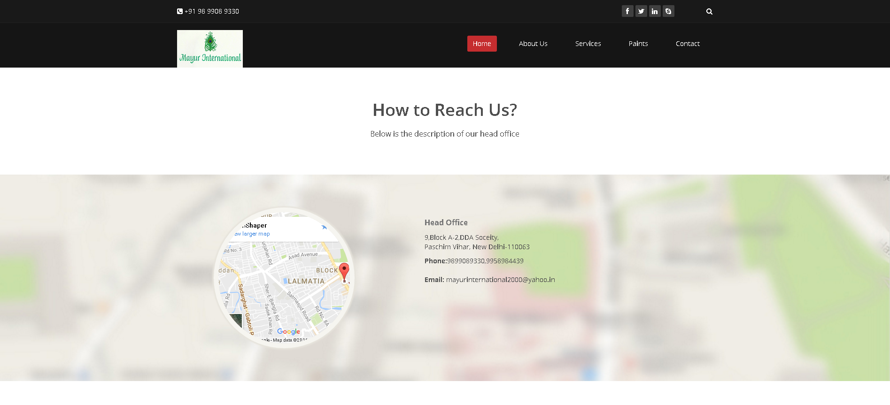
CONTACT US PAGE
This is the address section of the contact us page here I used an iframe for showing the location of the company’s office and for that I have used the google maps API

Slide 21
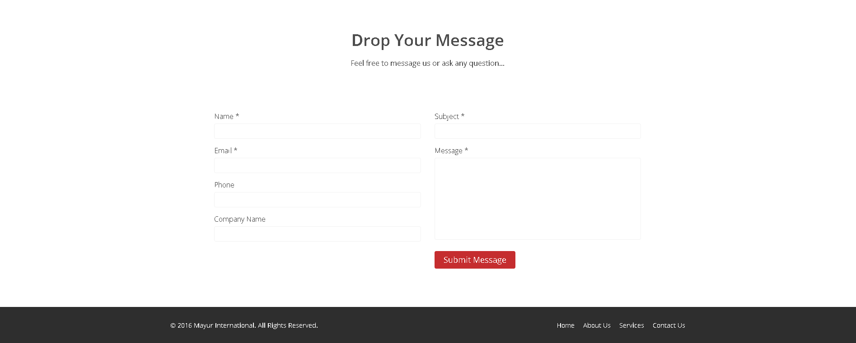
This is the Message section of the contact us page .
In this section I used php which will send an email from the company’s email id that they have received their message and would reply to them as soon as possible.

Slide 22
Things To work and Improve On
Would be adding a blog page where the company’s blogger can quote on.
For that ,I also need to learn and use more php for making a log on page for the bloggers of the company.
And for that, I also would have to learn about various tricks used by hackers like sql injection and how to counter them using php.
I would also add more pages and animations to the website as per the company’s need.

Slide 23
CONCLUSION
This website will help a user to know about the company’s vision and gives a brief about the product’s it deals with. If user visits this website he would given a brief about different paints that Mayur International deals with and would get to know about it’s employers and employees. This website uses html , css, JavaScript, Jquery ,php , json, bootstrap and various other libraries and api’s for various purposes. It is a dynamic and responsive website that can be used at any platform and various screen types and dimensions. I have made an attempt to make it user friendly. There is an option in its contact us page that will help the user to quote a question or a query to the company and they will get a mail instantly that the company will answer to them soon.

Slide 24
.
THANK YOU

